Slide 1

SCET-MITWPU
DeepTumorNet
Domain: Deep Learning
(In-House Project)
Names of Students with ERP Nos :
(PG 01) Dharmika Tank -1032210159
(PG 08) Jay Mehta -1032210499
(PG 18) Devanshu Surana -1032210755
(PG 28) Tejas Redkar -1032210937
Name of BTech Capstone Project Guide : Dr. Pratvina Talele
Is the project inhouse/industry sponsored : In-House
Number of Time Students met the Project Guide : 4
Are the slides approved by Project Guide YES/NO : -

Slide 2
Literature Survey
Sr No | Publication Title with authors [ mention whether Journal or Conference paper] | Publication Year | Positive points of the Publication | Gaps in publication work
1 | Lung Cancer Detection in Radiological Imaging using Deep Learning: A Review [N. S. Jozi and G. A. Al-Suhail, "Lung Cancer Detection in Radiological Imaging using Deep Learning: A Review," 2024 5th International Conference on Communications, Information, Electronic and Energy Systems (CIEES), Veliko Tarnovo, Bulgaria, 2024, pp. 1-8, doi: 10.1109/CIEES62939.2024.10811230.] (Conference) | 2024 | 1. Review state-of-the-art deep learning models for lung cancer detection. 2. Assess performance on different imaging modalities like CT scans and X-rays. 3. Analyze advancements, trends, and challenges in AI-driven lung detection. 4. Explore clinical applications for improved early detection and patient outcomes. 5. Emphasize the need for diverse datasets and model interpretability. 6. Investigate ethical concerns and deployment challenges in AI-based diagnostics. | 1. Limited dataset diversity leading to biases and reduced generalizability. 2. Lack of standardized evaluation metrics for model comparison. 3. Model interpretability issues making AI decisions less transparent. 4. Integration challenges preventing seamless adoption in clinical workflows. 5. High computational costs limiting real-time clinical applicability. 6. Ethical and legal concerns regarding data privacy, accountability, and transparency.

Slide 3
Sr No | Publication Title with authors [ mention whether Journal or Conference paper] | Publication Year | Positive points of the Publication | Gaps in publication work
2 | Enhancing Predictive Accuracy in Lung Disease Diagnosis Through Hybrid ResNet and Transfer Learning Models [S. Marappan, S. Roy, B. Ankayarkanni, S. Revathy and P. Asha, "Enhancing Predictive Accuracy in Lung Disease Diagnosis Through Hybrid ResNet and Transfer Learning Models," 2024 International Conference on Advances in Modern Age Technologies for Health and Engineering Science (AMATHE), Shivamogga, India, 2024, pp. 1-7, doi: 10.1109/AMATHE61652.2024.10582190.] (Conference) | 2024 | Improve Lung Disease Diagnosis Accuracy: 1. Develop a hybrid model combining ResNet and Transfer Learning to enhance predictive performance in lung disease classification. Utilize Deep Learning for Medical Imaging: 2. Compare multiple deep learning models (CNN, ResNet, Transfer Learning, and a Hybrid ResNet-Transfer Learning Model) for lung disease classification. Benchmark Model Performance: 3. Evaluate model accuracy, sensitivity, and F1-score, demonstrating the superiority of the hybrid approach. | Lack of Explainability Robustness: 1. Deep & learning models in healthcare often struggle with interpretability and robustness when diagnosing complex diseases. 2. The study emphasizes feature extraction and fusion techniques to enhance the model’s understanding of lung disease patterns. Need for Generalized Predictive Models: 3. Prior research often focused on specific lung diseases, limiting applicability. 4. The study extends deep learning across multiple lung conditions, making it more applicable for broad clinical use.

Slide 4
Sr No | Publication Title with authors [ mention whether Journal or Conference paper] | Publication Year | Positive points of the Publication | Gaps in publication work
3 | Real-time Detection of Lung Cancer Using CNN. [ N. S. Jozi and G. A. Al-Suhail, "Lung Cancer Detection in Radiological Imaging using Deep Learning: A Review," 2024 5th International Conference on Communications, Information, Electronic and Energy Systems (CIEES), Veliko Tarnovo, Bulgaria, 2024, pp. 1-8, doi: 10.1109/CIEES62939.2024.10811230.] (Conference) | 2024 | 1. Preprocessing & Model Optimization – Implements image normalization, resizing, and contrast enhancement for better accuracy. 2. CT Scan-Based Classification – Uses Convolutional Neural Networks (CNNs) to classify malignant vs. non-cancerous cases. 3. Real-time Lung Cancer Detection – Develop a CNN-based model for rapid lung cancer diagnosis. | 1. No Clinical Trials – Model is not tested in hospitals or integrated into radiology workflows. 2. No Multi-Modal Data Integration – Lacks fusion with additional clinical data like blood reports or symptoms. 3. Limited Explainability – No Grad-CAM or SHAP-based interpretability to aid radiologists.

Slide 5
Sr No | Publication Title with authors [ mention whether Journal or Conference paper] | Publication Year | Positive points of the Publication | Gaps in publication work
4 | Lung Cancer Prediction Model Using Ensemble Learning Techniques and a Systematic Review Analysis. [B. Sumithra, G. Vallathan, M. Raman Kumar and K. Govindharaju, "Deep Learning for Accurate Chest Disease Classification: A CNN-Based Approach for Lung Cancer Subtypes and Normal Cells," 2023 International Conference on System, Computation, Automation and Networking (ICSCAN), PUDUCHERRY, India, 2023, pp. 1-7, doi: 10.1109/ICSCAN58655.2023.10394855.] (Conference) | 2023 | 1. Develop an effective machine learning-based prediction model for lung cancer diagnosis. 2. Applied and compared different ensemble learning techniques such as XGBoost, LightGBM, Bagging, and AdaBoost. 3. Evaluating the models using accuracy, precision, recall, F1-score, and AUC. 4. Use SMOTE (Synthetic Minority Oversampling Technique) to balance the dataset and improve model reliability. | 1. Most past studies focused on single classifiers like SVM, Random Forest, or Naïve Bayes, without leveraging ensemble learning techniques. 2. Many previous models used imbalanced datasets, leading to biased predictions. The study addressed this using SMOTE. 3. Existing models often relied on specific datasets that were not representative. The study highlights the need for larger and more diverse datasets for better generalization.

Slide 6
Sr No | Publication Title with authors [ mention whether Journal or Conference paper] | Publication Year | Positive points of the Publication | Gaps in publication work
5 | Deep Learning for Accurate Chest Disease Classification: A CNN-Based Approach for Lung Cancer Subtypes and Normal Cells. [I. V. and D. Menaka, "Real-time detection of Lung cancer using CNN," 2023 2nd International Conference on Vision Towards Emerging Trends in Communication and Networking Technologies (ViTECoN), Vellore, India, 2023, pp. 1-6, doi: 10.1109/ViTECoN58111.2023.10157316.] (Conference) | 2023 | 1. Lung Cancer Subtype Classification – Identify Adenocarcinoma, Large Cell Carcinoma, Squamous Cell Carcinoma, and Normal Cells. 2. AI-Powered Diagnosis – Implement CNNs for accurate chest disease classification. 3. High-Performance Model – Optimize accuracy, precision, recall, and AUC-ROC. 4. Clinical Validation – Ensure model aligns with real-world medical diagnostics. 5. Explainability – Use Grad-CAM for visualization of decision-making areas. | 1. Limited Interpretability – Grad-CAM used, but lacks detailed explainability techniques like SHAP/LIME. 2. Lack of Transfer Learning – No use of pre-trained models for enhanced feature learning. 3. No 3D Image Analysis – Model is 2D-based, missing depth details in lung scans.

Slide 7
Sr No | Publication Title with authors [ mention whether Journal or Conference paper] | Publication Year | Positive points of the Publication | Gaps in publication work
6 | Lung Cancer Detection and Classification Using Deep CNN. [A. Rehman, M. Kashif, I. Abunadi and N. Ayesha, "Lung Cancer Detection and Classification from Chest CT Scans Using Machine Learning Techniques," 2021 1st International Conference on Artificial Intelligence and Data Analytics (CAIDA), Riyadh, Saudi Arabia, 2021, pp. 101-104, doi: 10.1109/CAIDA51941.2021.9425269.] (Journal) | 2021 | 1. Early Cancer Detection using CNN on chest CT scans. 2. Automated Diagnosis with deep learning for benign vs. malignant classification. 3. End-to-End AI Pipeline including preprocessing, segmentation, and classification. 4. Performance Evaluation with metrics like accuracy (96%), precision, recall, etc. | 1. Hyperparameter Tuning Needed – No AutoML/advanced optimizations. 2. No Cloud Deployment – Misses AWS/GCP integration for real-time AI diagnosis. 3. Limited Explainability – No Grad-CAM/SHAP for AI interpretability.

Slide 8
Sr No | Publication Title with authors [ mention whether Journal or Conference paper] | Publication Year | Positive points of the Publication | Gaps in publication work
7 | Lung Cancer Detection with Machine Learning and Deep Learning: A Narrative Review. [ N. Nawreen, U. Hany and T. Islam, "Lung Cancer Detection and Classification using CT Scan Image Processing," 2021 International Conference on Automation, Control and Mechatronics for Industry 4.0 (ACMI), Rajshahi, Bangladesh, 2021, pp. 1-6, doi: 10.1109/ACMI53878.2021.9528297.] (Conference) | 2021 | 1. AI for Lung Cancer Detection – Explore the role of Machine Learning (ML) and Deep Learning (DL) in improving lung cancer diagnosis. 2. Automated Image Processing – Use AI-based Computer-Aided Detection (CAD) systems for lung nodule detection. | 1. Feature Extraction Needs Improvement – Requires better hybrid AI models (ML + DL) for enhanced performance. 2. Dataset Limitations – Uses small datasets, limiting generalization. 3. No Real-World Clinical Testing – Not validated in hospitals for real time diagnostics.

Slide 9
Sr No | Publication Title with authors [ mention whether Journal or Conference paper] | Publication Year | Positive points of the Publication | Gaps in publication work
8 | Lung Cancer Detection and Classification from Chest CT Scans Using Machine Learning Techniques [A. Rehman, M. Kashif, I. Abunadi and N. Ayesha, "Lung Cancer Detection and Classification from Chest CT Scans Using Machine Learning Techniques," 2021 1st International Conference on Artificial Intelligence and Data Analytics (CAIDA), Riyadh, Saudi Arabia, 2021, pp. 101-104, doi: 10.1109/CAIDA51941.2021.9425269.] (Conference) | 2021 | 1. Machine Learning-Based Classification – Using Support Vector Machine (SVM) and K-Nearest Neighbors (KNN) for accurate classification. 2. Clinical Impact – Aims to improve cancer detection and assist radiologists diagnosis. 3. Early Lung Cancer Detection – Identify Adenocarcinoma, Large Cell Carcinoma, Squamous Cell Carcinoma from CT scan. | 1. Lack of Clinical Validation – Model is not tested in real-world hospitals or integrated into radiology workflows. 2. Annotation Challenges – Potential noise in labeled datasets affecting accuracy.

Slide 10
Sr No | Publication Title with authors [ mention whether Journal or Conference paper] | Publication Year | Positive points of the Publication | Gaps in publication work
9 | Deep Learning Methods for Lung Cancer Segmentation in Whole-Slide Histopathology Images [Z. Li et al., "Deep Learning Methods for Lung Cancer Segmentation in Whole-Slide Histopathology Images—The ACDC@LungHP Challenge 2019," in IEEE Journal of Biomedical and Health Informatics, vol. 25, no. 2, pp. 429-440, Feb. 2021, doi: 10.1109/JBHI.2020.3039741.] (Journal) | 2020 | 1. Automated Cancer Segmentation – Develop deep learning methods to accurately segment lung cancer tissues in whole-slide histopathology images (WSI). 2. Challenge Benchmarking – The ACDC@LungHP Challenge 2019 aimed to evaluate different AI-based segmentation methods on lung cancer WSI. 3. Model Evaluation – Assess CNN-based models using metrics like Dice Coefficient (DC), Precision, Sensitivity, and Specificity. 4. Multi-Model vs. Single Model Performance – Compare the effectiveness of multi-model vs. single-model architectures. 5. Enhance Pathologists' Workflow – Use AI to assist in cancer tissue reducing pathologists’ workload. | 1. Lack of Clinical Deployment – Model not tested in real-world pathology labs. 2. Limited Performance on Challenging Cases – Models struggled with complex tumor structures, reducing accuracy. 3. No Integration with Cloud AI – The study does explore not scalable cloud-based implementations for remote pathology.

Slide 11
Sr No | Publication Title with authors [ mention whether Journal or Conference paper] | Publication Year | Positive points of the Publication | Gaps in publication work
10 | Lung Cancer Detection and Classification using CT Scan Image Processing. [Z. Li et al., "Deep Learning Methods for Lung Cancer Segmentation in Whole-Slide Histopathology Images—The ACDC@LungHP Challenge 2019," in IEEE Journal of Biomedical and Health Informatics, vol. 25, no. 2, pp. 429-440, Feb. 2021, doi: 10.1109/JBHI.2020.3039741] (Journal) | 2020 | 1. To propose a novel approach for lung cancer detection and classification using CT scan image processing. 2. To implement image preprocessing techniques such as smoothing and enhancement for better image quality. 3. To apply thresholding and edge detection methods for segmentation of the lung tumor region from the lung mask. 4. To extract geometrical features like area, perimeter, eccentricity, compactness, and circularity of the segmented tumor regions. 5. To classify the extracted features into benign or malignant tumors using a Support Vector Machine (SVM) classifier. 6. To evaluate the performance of the proposed system in terms of accuracy and detection of lung cancer nodules. | 1. Existing methods for lung cancer detection using CT scans often require prior information, which limits the accuracy and applicability in real-world scenarios. 2. Many current approaches for lung cancer classification focus on only benign or malignant detection but lack clear distinction in the severity stages. 3. Image preprocessing methods, such as filtering and enhancement, have room for optimization to improve segmentation and feature extraction processes. 4. There is a need for more reliable and generalized classification models that can work efficiently across different datasets without manual adjustments. 5. ⁠Current methods lack robustness in handling noise and artifacts in CT images, which can lead to incorrect tumor identification and classification.

Slide 12
Identified Gaps in Existing Literature
Limited Interpretability – Reliance on Grad-CAM, lacking SHAP and LIME for better transparency.
No Transfer Learning – Models miss out on pre-trained architectures for improved feature learning.
No 3D Image Analysis – Focus on 2D imaging, ignoring crucial depth information in lung scans.
Dataset Issues – Small, non-diverse datasets cause biases and limit generalization.
No Standard Metrics – Lack of universal benchmarks makes model comparisons difficult.
Clinical Deployment Issues – AI models are not tested in real hospital settings.
High Computational Costs – Expensive models hinder real-time clinical use.
Ethical & Legal Concerns – Issues with data privacy, accountability, and explainability.

Slide 13
Justification of the Problem Statement
To bridge these gaps, this research proposes an end-to-end AI-driven chest cancer detection system that is interpretable, computationally efficient, and clinically deployable. The following enhancements will be incorporated:
Enhanced Interpretability – Integrate SHAP and LIME with Grad-CAM for better AI explainability.
Transfer Learning – Use pre-trained models (ResNet, EfficientNet) for improved feature extraction and accuracy.
3D Image Analysis – Develop models for 3D lung CT scans to enhance tumor detection.
Diverse Datasets – Use multi-source data and augmentation to reduce biases and improve generalization.
Standardized Metrics – Implement AUC-ROC, sensitivity, and F1-score for better model comparisons.
Clinical Integration – Collaborate with hospitals for real-world testing and cloud-based deployment.
Computational Efficiency – Optimize AI models using quantization and pruning for faster diagnoses.
Ethical & Legal Compliance – Ensure data privacy with federated learning and transparent AI protocols.

Slide 14
Requirements Gathering
Dataset : https://universe.roboflow.com/lung-cancer-3gsnq/lung-cancer-dataset
Orchestration Tools (Software): MLFlow - https://mlflow.org/
DVC - https://dvc.org/
Hardware - Intel i5 Processor, 8 GB RAM, 512 SSD

Slide 15
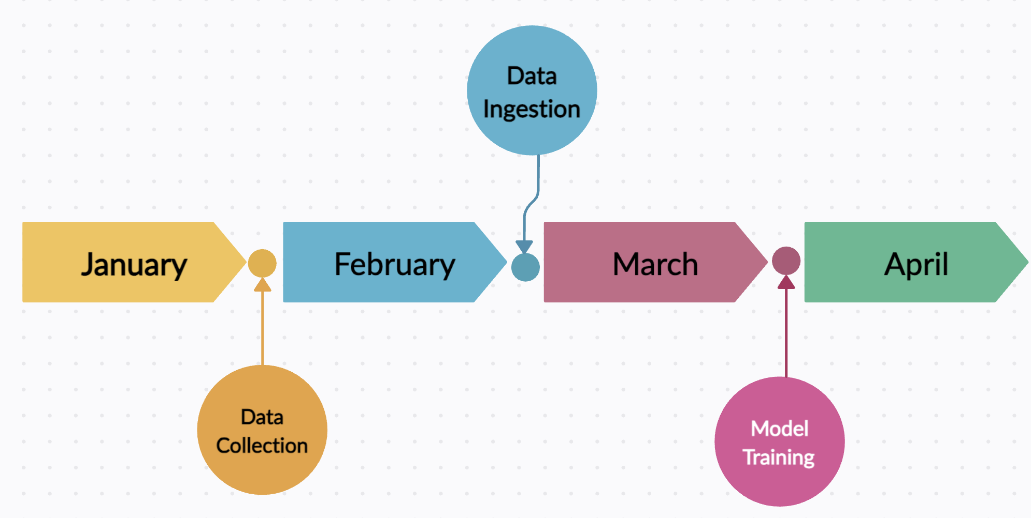
Project Timeline Diagram

Slide 16
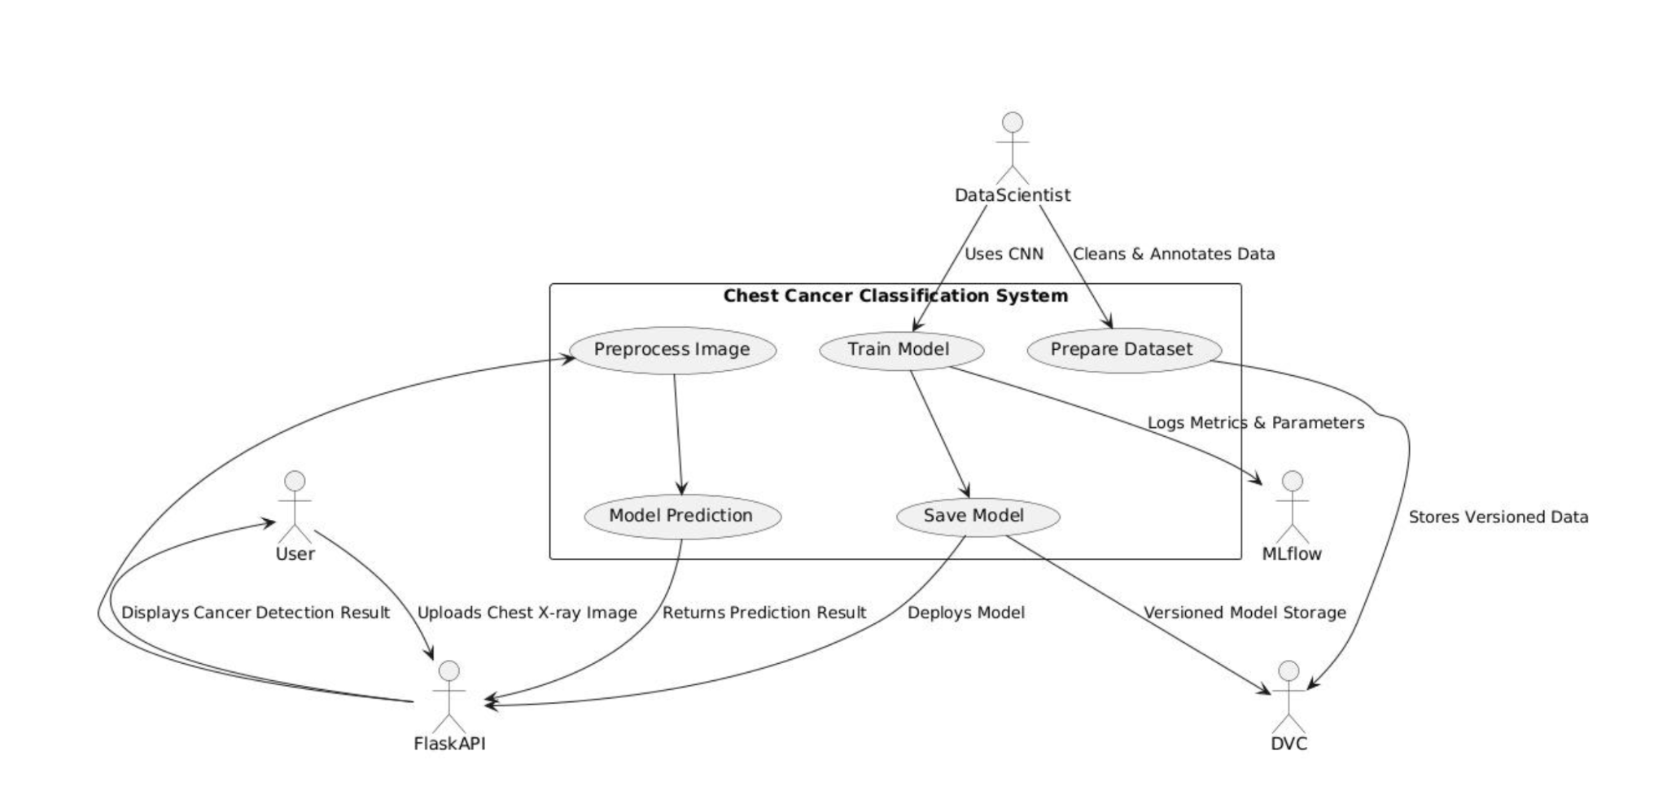
System Design [ Entire system] - Team Approach

Slide 17
Publication details
Literature Review on DeepTumorNet
1. Introduction
Lung cancer is a leading cause of cancer-related deaths, with early detection crucial for survival. Traditional diagnostic methods are time-consuming and error-prone. AI and deep learning offer automated, accurate solutions. This paper reviews AI-driven lung cancer detection methods, key challenges, and future directions.
2. Existing Work
CNN-Based Detection: Identifies lung nodules and classifies them as benign or malignant.
Subtype Classification: Differentiates adenocarcinoma, squamous cell carcinoma, etc.
Segmentation Techniques: AI-driven identification of cancerous regions in CT scans.
Hybrid Approaches: Combines deep learning with traditional ML methods for better accuracy.
Performance Metrics: Evaluations based on accuracy, precision, recall, AUC-ROC, etc.

Slide 18
Publication details
3. Challenges & Gaps
Limited Interpretability: AI models function as black boxes.
Dataset Limitations: Small, imbalanced datasets reduce generalization.
Lack of Clinical Validation: Models remain untested in real-world settings.
Hyperparameter Tuning: Most studies lack automated optimization.
Cloud Integration: Few implementations support real-time diagnostics.
4. Conclusion
AI is transforming lung cancer detection but needs improvements in interpretability, dataset quality, and clinical validation. Future research should focus on explainability, data integration, and real-world deployment.

Slide 19
Future Directions
Explainable AI (XAI): Enhance model transparency by using techniques like Grad-CAM to visualize important regions in CT scans and SHAP to analyze feature contributions in predictions.
Transfer Learning: Improve model performance by leveraging pre-trained deep learning models, allowing better feature extraction and faster training on lung cancer datasets.
Multi-Modal Data Fusion: Integrate imaging data with patient clinical records, genetic markers, and lab reports to enhance diagnostic accuracy and provide a holistic analysis.
Cloud-Based Deployment: Deploy AI models on cloud platforms like AWS or GCP, enabling real-time, scalable diagnostics for hospitals and healthcare providers.
Clinical Trials: Conduct real-world validation by testing AI models on patient data in collaboration with medical professionals to ensure reliability and clinical applicability.

Slide 20
Thank You

